Slide 1
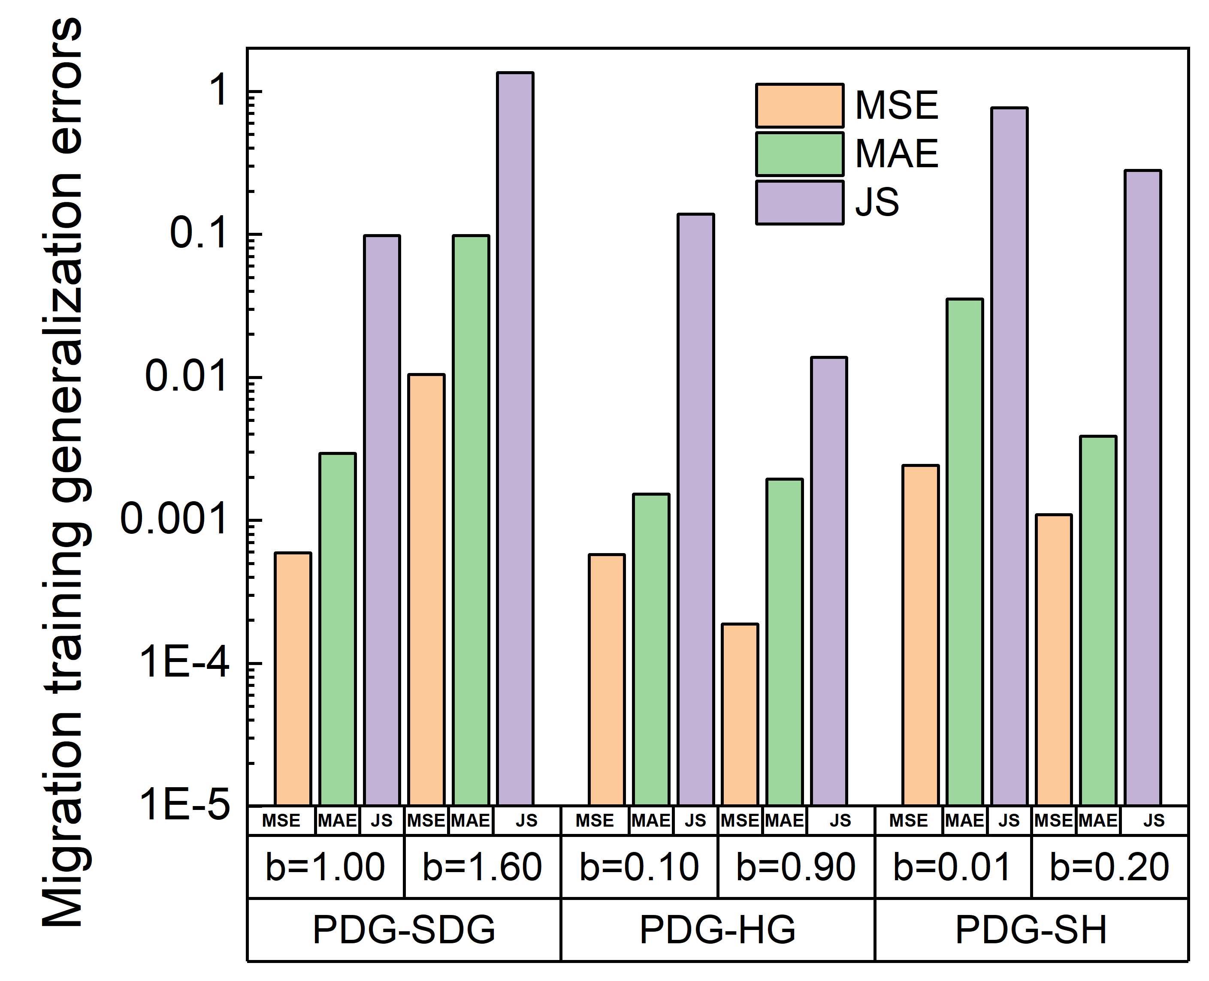

Slide 2
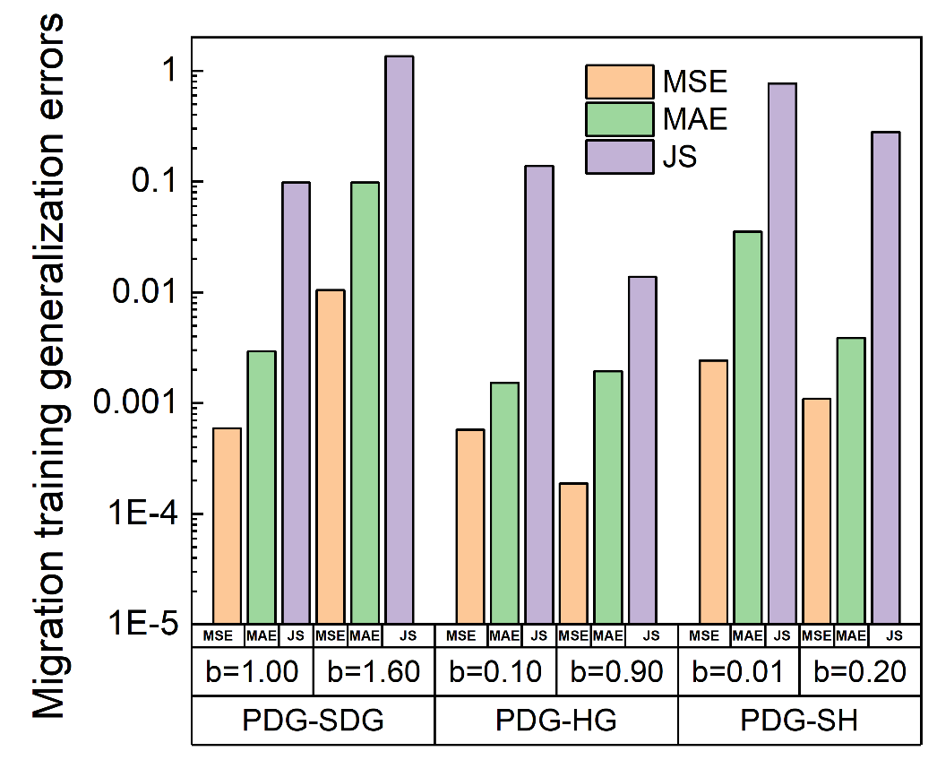
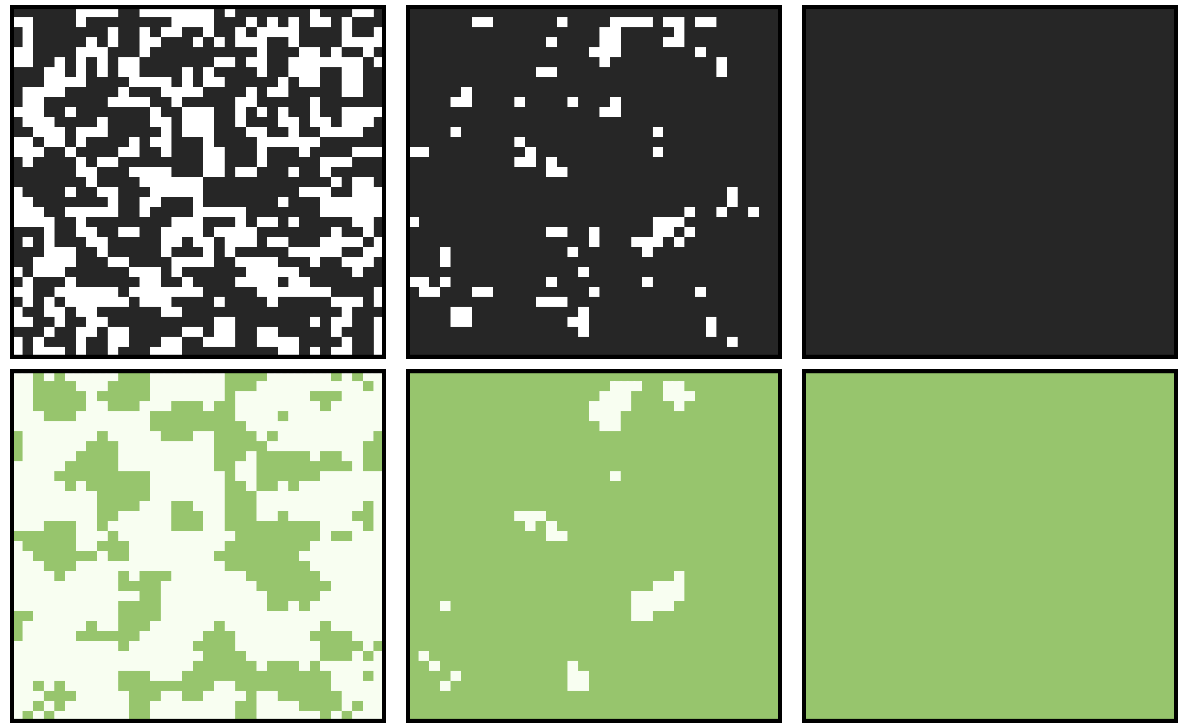
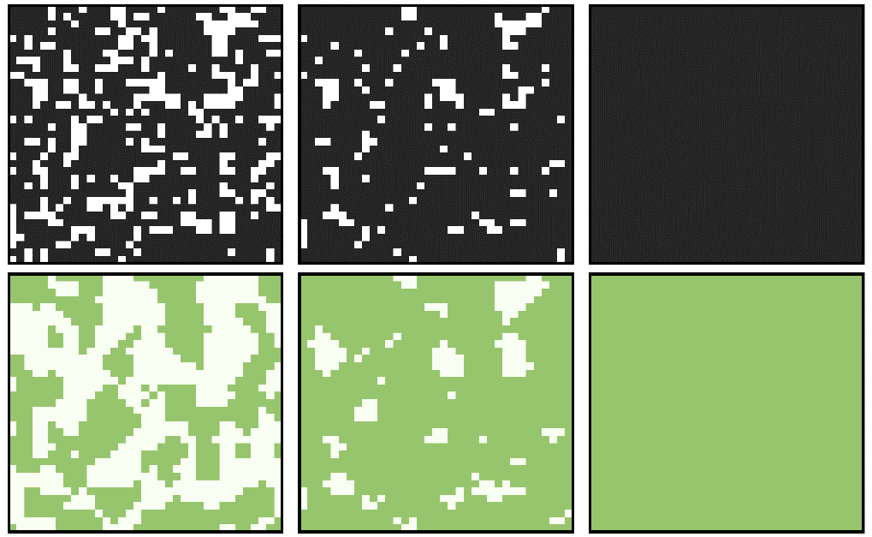
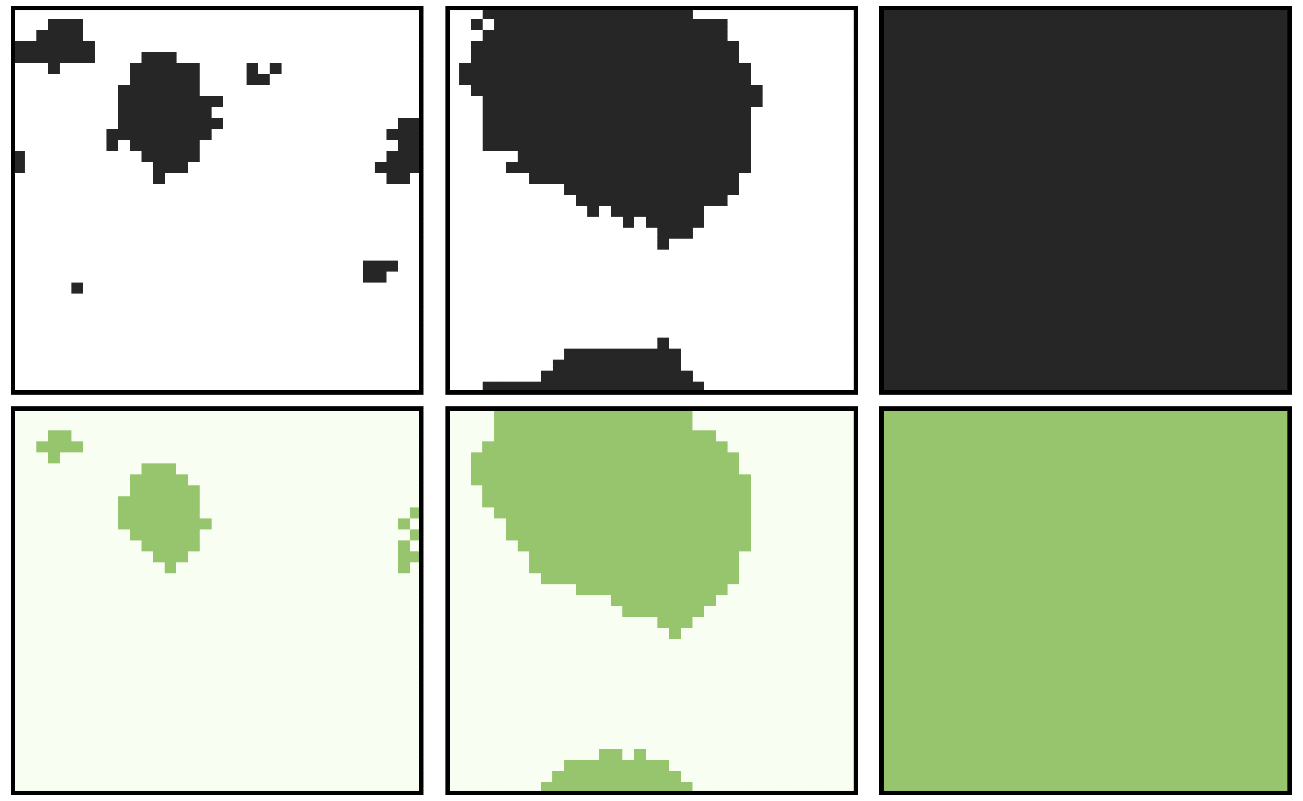
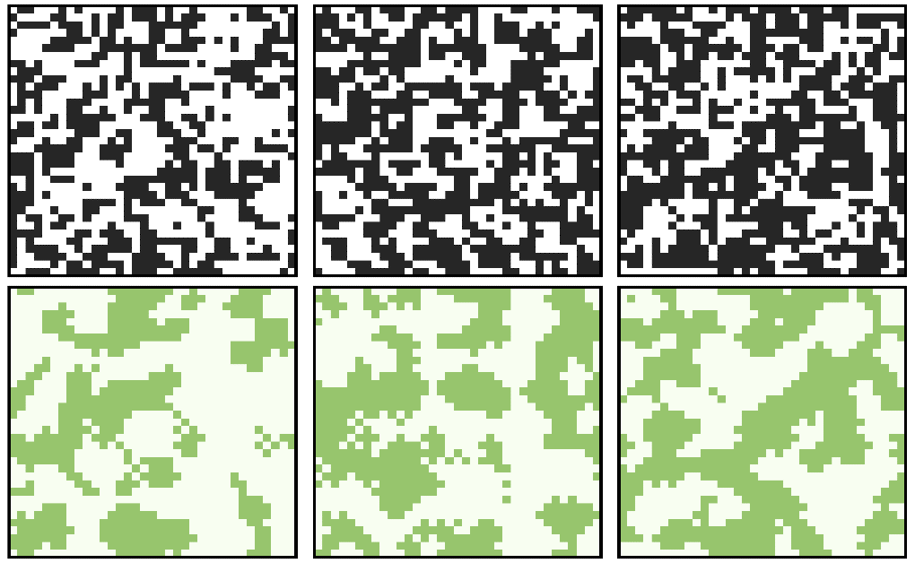
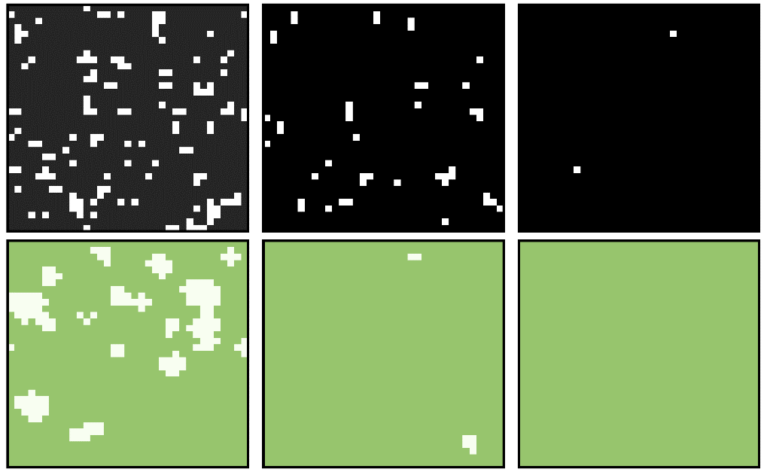
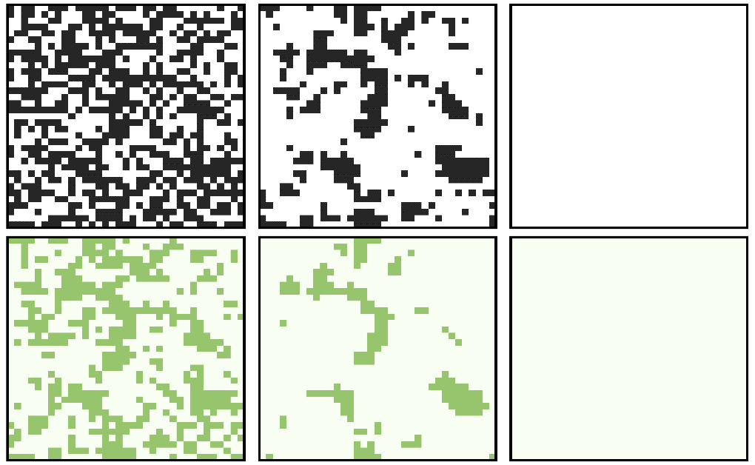

Slide 3
PDG
SDG
HG
SH

Slide 4

(a)
(c)
PDG
1
HG
SDG
Training (70%)
Validation (5%)
0
Sucker
Test (25%)
GCN+TMIFE
SH
PDG
-1
0
1
2
Temptation, b
(b)
Well-trained Model
C
C
(d)
SDG
(test only)
HG
(test only)
SH
(test only)
D
Payoff
F_{t}
Round
t
b=1.00
b=0.10
b=0.01
C
D
C
C
C
Payoff
F_{t+1}
Round
t+1
C
D
b=1.60
b=0.90
b=0.20
C
C
Round
t+2
Payoff
F_{t+2}
C
C
C

